Slide 1
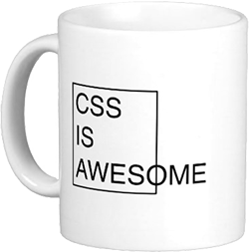
Do’s and dont’s
Christoffer Noring Softhouse

Slide 2
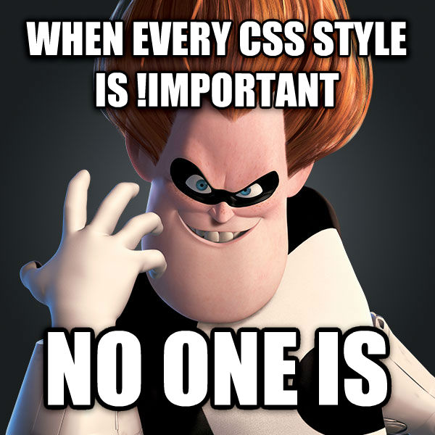
Cheater styles
If you must then create a hack.css so you know that you have
created hacks that you plan to remove
!important
position:absolute

Slide 3

Inline styles
<div style=”background:black; font-weight: bold …”
HOW ’BOUT NO

Slide 4
Specificity
Known Specificity
ID
Don’t create css based on ID very hard to override
Class
Class is the best
Tag
Don’t do it on tags either

Slide 5
Don’t create Long selectors, aka greater than three levels deep
Example
mimics the HTML layout rather than abstracting the design elements
.menu ul li a {}
hard to debug
Rule of three

Slide 6
DRY violations
Group identical styles
Modifier class
.bold {
font-weight: bold;
}
.nice-title, .other-title{
font-weight: bold;
}
.nice-title{
font-size: 18px;
}
.other-title{
font-size: 24px;
color:red;
}
Break out the common part
.nice-title {
font-weight: bold;
font-size : 12px;
}
.other-title {
font-weight: bold;
font-size : 14px;
}
OR
<div class="nice-title">
some text
</div>
<div class="other-title">
some text
</div>
<div class=”nice-title bold” ></div>

Slide 7
Mixing units
px, em, rem , BE CONSISTENT

Slide 8
Forgetting to support all browsers
-webkit-border-radius: 10px;
-moz-border-radius: 10px;
border-radius: 10px;
-webkit-box-shadow: 7px 7px 5px 0px rgba(50, 50, 50, 0.75);
-moz-box-shadow: 7px 7px 5px 0px rgba(50, 50, 50, 0.75);
box-shadow: 7px 7px 5px 0px rgba(50, 50, 50, 0.75);
Write a mixin to support all types or use an existing sass/less lib that does this
Just DONT forget

Slide 9
Organizing your sass files
/* VENDOR - Default fall-backs and external files.
========================================================================== */
@import 'vendor/normalize';
/* BASE - Base Variable file along with starting point Mixins and Placeholders.
========================================================================== */
@import 'base/variables';
@import 'base/mixins';
@import 'base/placeholders';
/* FRAMEWORK - Structure and layout files.
========================================================================== */
@import 'framework/grid';
@import 'framework/breakpoints';
@import 'framework/layout';
/* MODULES - Re-usable site elements.
========================================================================== */
@import 'modules/buttons';
@import 'modules/_lists.scss';
@import 'modules/_tabs.scss';
vendor/
_variables.scss
_mixins.scss
_placeholders.scss
modules /
global.scss

Slide 10
Breakdown
placeholder
.test{
@extend %a_placeholder
@include a_mixin
color : white
&:hover {
}
&::before {
}
.title {
}
}
mixin
Regular css
Pseudo classes and pseudo elements
Nested selectors

Slide 11
Sass variables
Be specific
What but also more exact, primary
BAD
GOOD
$link: #ffa600;
$listStyle: none;
$radius: 5px;
$link-primary: $orange;
$radius-button: 5px;
$radius-tab: 5px;
Radius for what?
Radius for tab

Slide 12
Sass, mixins
At least one argument or you create too many
GOOD, can be used for different radius numbers
BAD
@mixin border-radius($arc) {
-moz-border-radius: $arc;
-webkit-border-radius: $arc;
border-radius: $arc;
}
@mixin border-radius {
-moz-border-radius: 12px;
-webkit-border-radius: 12px;
border-radius: 12px;
}
NOT very flexible

Slide 13
Sass, placeholder vs mixin- placeholder
If you have no parameters, use a placeholder because it saves codelines
%button {
border-radius: 4px;
padding: 5px;
}
.blue-button {
color : blue;
@extend %button;
}
.cool-button {
color : white;
background: black;
@extend %button;
}
Attributes is not doubled, written only once
.blue-button, cool-button{
border-radius : 4px;
padding: 5px
}
.blue-button{
color : blue;
}
.cool-button{
color:white;
}

Slide 14
Sass, placeholder vs mixin- mixin
@mixin button {
border-radius: 4px;
padding: 5px;
font-size : 12px;
}
.blue-button {
color : blue;
@include ’button’;
}
.cool-button {
color : white;
background: black;
@include ’button’;
}
.blue-button{
border-radius : 4px;
padding: 5px;
font-size : 12px;
color : blue;
}
.cool-button{
border-radius : 4px;
padding: 5px;
font-size : 12px;
color:white;
}
The more properties in mixin the larger the css

Slide 15
Never Write Vendor Prefixes
a {
transition: transform 1s
}
But you said?...
Vendor prefixes are a time-sensitive thing.
As browsers update over time, the need for them will fall away.
Becomes
a {
-webkit-transition: -webkit-transform 1s;
transition: -ms-transform 1s;
transition: transform 1s
}
What do you suggest?
Autoprefixer by Andrey Sitnik
https://css-tricks.com/autoprefixer/
parses CSS files and adds vendor prefixes to CSS rules using the Can I Use database to determine which prefixes are needed.

Slide 16
Working with sass differently in dev and prod
With source maps in dev
sass sass/app.scss:dest/app.css --sourcemap

Slide 17
Code demo, source maps + autoprefixer

Slide 18

Don’t reinvent the wheel
There are excellent sass libs out there
Buttons
http://unicorn-ui.com/buttons/builder//
Saffron – for animations
http://colindresj.github.io/saffron/

